Slide 1
Genome assembly Bioinformatics Applications (PLPTH813)
Sanzhen Liu
3/28/2019

Slide 2
QTL mapping
A Quantitative Trait Locus (QTL) is a genomic locus that genetically influence variation in a phenotype of a quantitative trait.
Population
traits of interest: phenotyping
Certain platform: genotyping
QTLs

Slide 3
LOD (logarithm of the odds)
Prob(pheno data | geno data; a QTL at a given position)
Prob(pheno data | geno data; no QTL)
LOD = log₁₀
LOD = log₁₀ likelihood ratio, comparing a single-QTL model to the “no QTL anywhere”.
The LOD score is a measure of the strength of evidence for the presence of a QTL at a particular location.
LOD scores must be closer to 3 before they will generally be deemed interesting. - Broman, Lab Animal, 30(7):44–52, 2001
Notes:
the likelihood of a QTL at a location is 1000 times as that of no QTLs

Slide 4
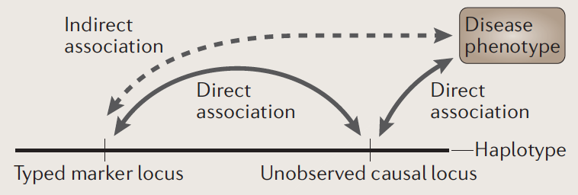
Linkage disequilibrium (LD)
Linkage disequilibrium (LD): a non-random association of alleles at different loci; genotyping data at two loci have some level of correlations
Association is NOT equal to causality

Slide 5
Spurious associations
Early flowering
Later flowering
population 1
population 2
Flowering time is confounded with Populations
Notes:
simply population 1 were represented at a higher proportion in the group of "early flowering".

Slide 6
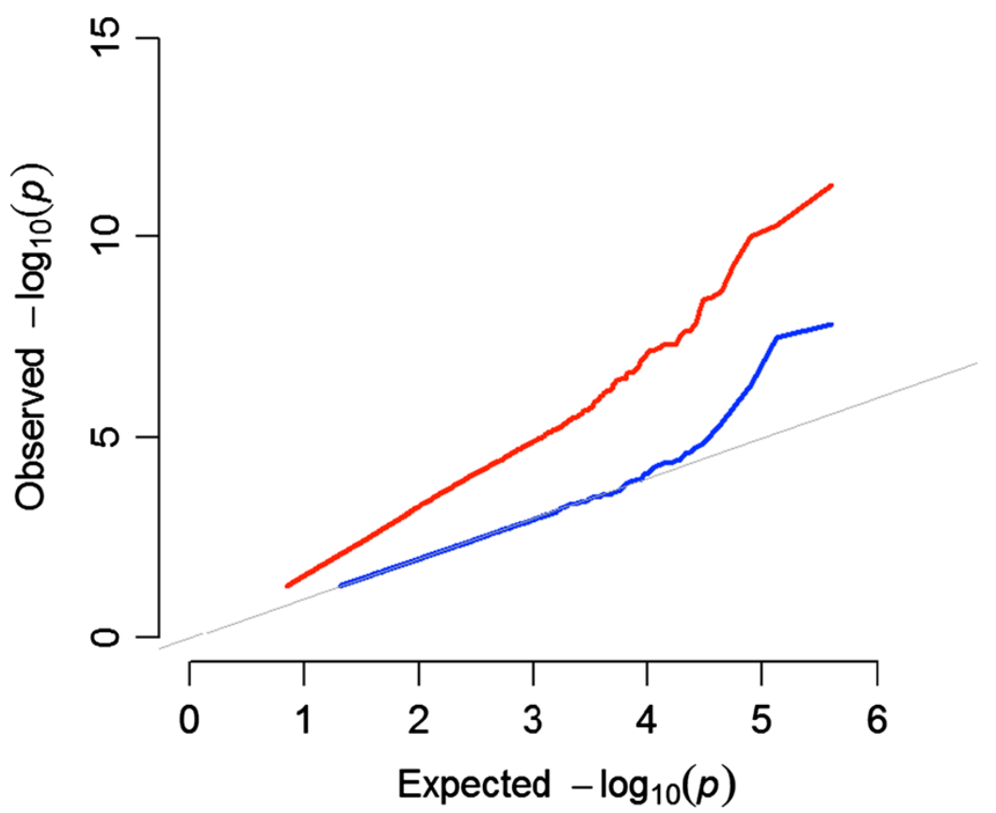
Mixed linear model (Q+K MLM)
The mixed model (blue) dramatically reduces inflation of p-values

Slide 7
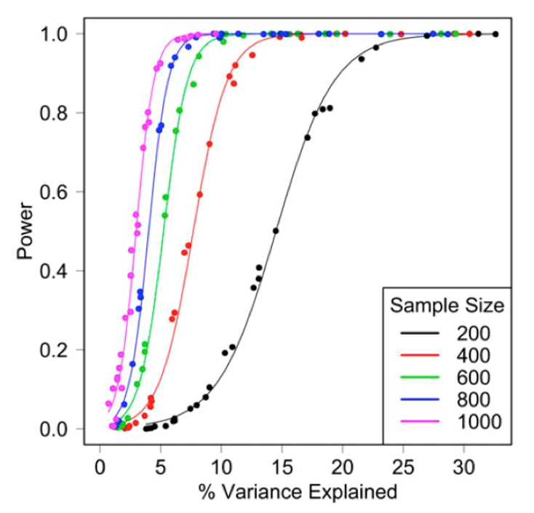
The lower the effect of causal sites, the larger the sample size is needed
Species | year | Journal | Population size | Trait
Cotton | 2017 | NG | 318 | Fiber and yield
Cotton | 2017 | NG | 352 | Fiber quality
Rice | 2016 | NG | 176 | Agronomic traits
Rice | 2016 | NG | 342 | Grain shape
Rice | 2016 | Nature | 10,074 | Heterotic effects
from Ruolin, Upasana, Diriba

Slide 8
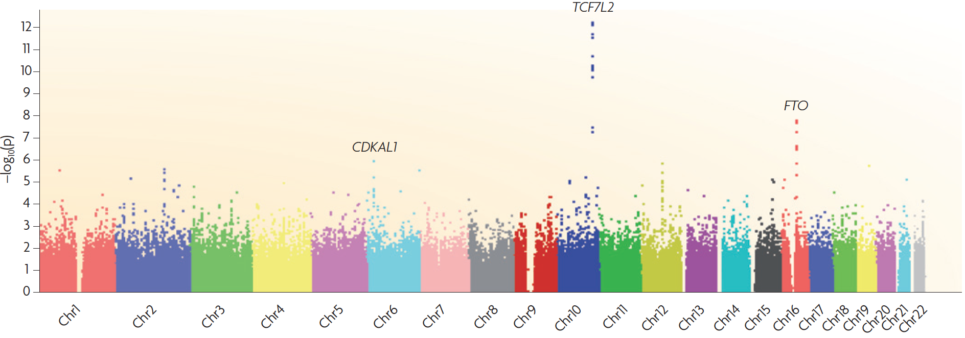
Manhattan plot
McCarthy et al., Nature Review Genetics, 2008: 9:356-369
association does not imply causation

Slide 9
Outline
Genome assembly: concept
Assembly algorithms: OLC/De Bruijn graph
Error correction (Kmer counts)
Assembly strategy to cope with the repeat problem
(mate-pair reads, long reads, others)
Assembly evaluation (N50, comparison to a reference genome)
Genome annotation
Case study

Slide 10
Whole genome shotgun (WGS) sequencing
chromosome
sequencing
reads

Slide 11

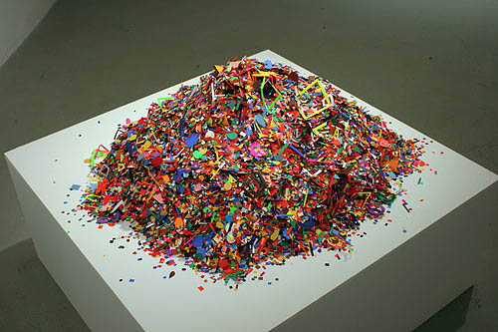
Complexity of genome assembly
criticalmiami.com/
dreamstime.com
Algorithm Can Solve 10, 000 Piece Jigsaw in 24 Hours

Slide 12
Genome assembly
sequencing
reads
unitigs, superreads
contigs
scaffolds
NN..NN
complete assembly / pseudochomosome

Slide 13
Assembly algorithms
Overlap layout consensus (OLC)
all-to-all pair-wise read alignments
Construct graph based on overlaps
Trace paths for the assembly
De Bruijn graph
Determine k-mer from reads
Construct k-mer graph
Trace paths for the assembly

Slide 14
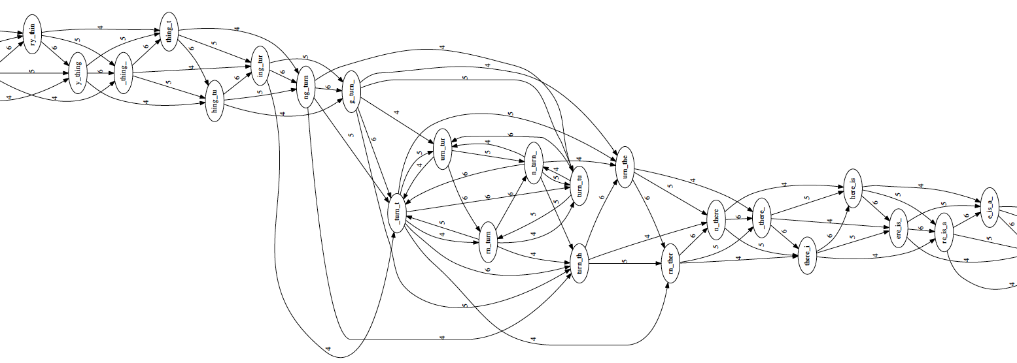
Overlap layout consensus (I)
Overlap graph
to identify all pairs of reads that overlap sufficiently well
to organize the overlapping information into a graph containing a node for every read and an edge between any pair of reads that overlap each other.
Overlap
Layout
Consensus
to_every_thing_turn_turn_turn_there_is_a_season
l = 4 (minimum overlap)
k = 7 (read length)
langmead-lab.org/teaching-materials

Slide 15
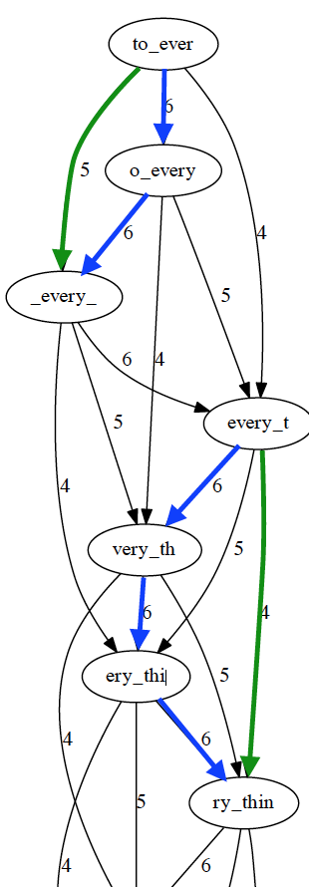
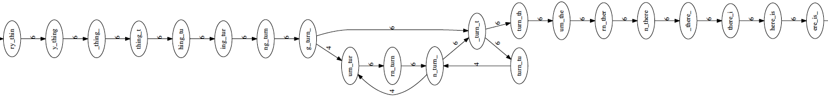
Overlap layout consensus (II)
Overlap
Layout
transitive edges: edges that skip one or more nodes
Consensus
Layout (string graph)
to simplify the global overlap graph by removing redundant information (transitive edges)
langmead-lab.org/teaching-materials

Slide 16
Overlap layout consensus (III)
Overlap
Layout
Simplifies the global overlap graph by removing redundant information
Emits contigs corresponding to the non-branching paths
Layout
Consensus
contig 1
to_every_thing_turn_
unresolved repeat (gap)
contig 2
turn_there_is_a_season
to_every_thing_turn_turn_turn_there_is_a_season
langmead-lab.org/teaching-materials

Slide 17
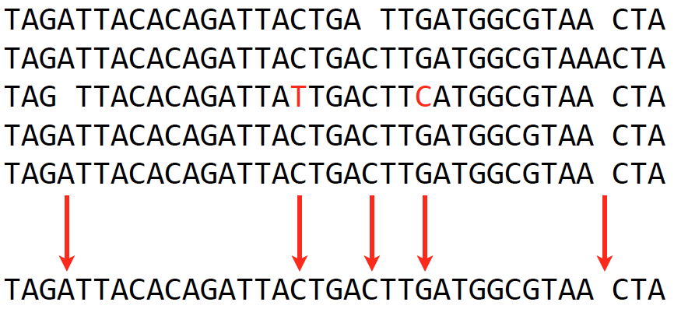
Overlap layout consensus (IV)
Overlap
Consensus
Extract consensus sequences (major votes) based on the alignment of reads that make up a contig
Layout
Consensus
langmead-lab.org/teaching-materials

Slide 18
OLC drawbacks
Identifying all-to-all overlaps is a slow procedure, especially when read number is millions or billions.
Overlap graph is big when the read number is huge. One node per read, and in practice the number of edges grows superlinearly with the number of reads.
The computational complexity limits its application.

Slide 19
De Bruijn graph – k-mer
De Bruijn graph assemblers model the relationship between exact substrings of length k (k-mer) extracted from input reads.
(k=3)
reads
A T G G C G T
k-mer (k=3)
ATG
TGG
GGC
GCG
CGT
Compeau et al., 2011. Nature Biotechnology 29: 987-991.

Slide 20
Problem: list all K-mers (k=4)
CGATCGATCGATCGAT

Slide 21
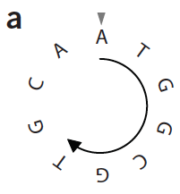
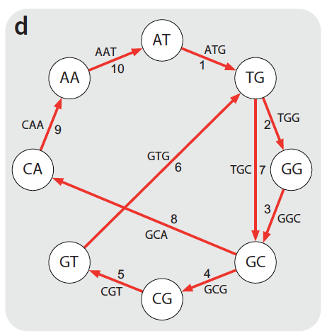
De Bruijn graph - assembly
k-mer (k=3)
genome
sequence
C
ATG
TGG
GGC
GCG
CGT
GTG
TGC
GCA
CAA
AAT
De Bruijn graph
b
ATGGCGT
GGCGTCG
CTTGCAA
TGCAATG
CAATGGC
ATGGCGT
reads
edge
ATG
AT
TG
visit each edge once
Node
ATGGCGTGCAATG
Compeau et al., 2011. Nature Biotechnology 29: 987-991.

Slide 22
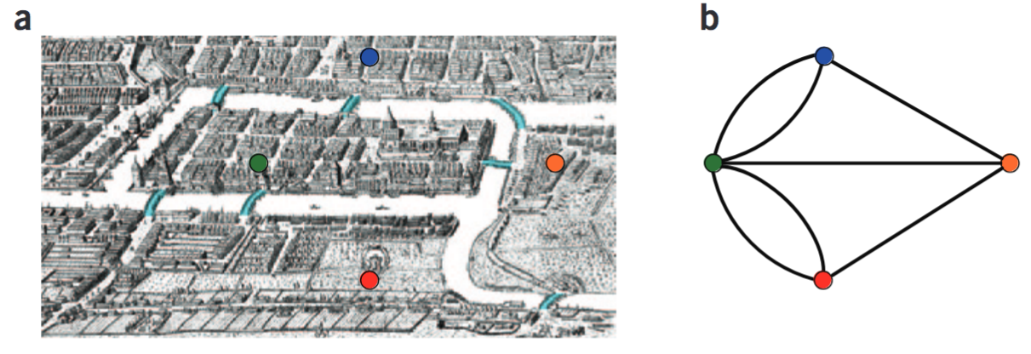
de Bruijn algorithm
To find a path containing all k-mers but also is as short as possible, as it contains each k-mer exactly once.
De Bruijn answered this question by borrowing Euler’s solution of the Bridges of Königsberg problem. An Eulerian cycle represents a shortest path that contains each k-mer exactly once.
Compeau et al., 2011. Nature Biotechnology 29: 987-991.

Slide 23
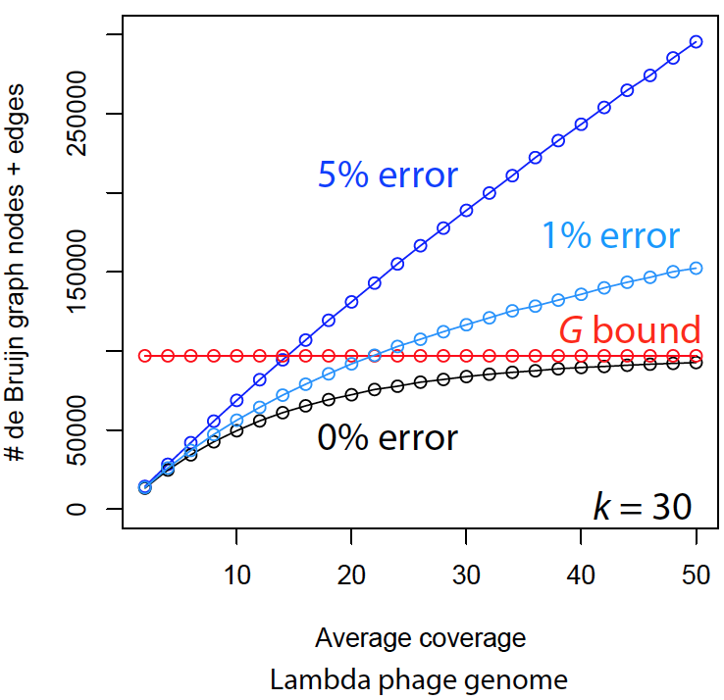
Sequencing errors complicate assemblies
The complexity of De Bruijn graph grows when reads contain errors.
Reads
TGCGTGA
TGCGTGA
TGCGTGA
TGGGTGA
k-mer count profile (k=5)
G: genome
TGCGT
GCGTG
CGTGA
TGGGT
GGGTG
GGTGA
langmead-lab.org/teaching-materials
Sequence error correction before graph construction is a critical step for De Bruijn graph assembly.

Slide 24
Error identification
Reads (depth = 10)
k-mer count profile (k=5)
TGCGTGATACG
TGCGTGATACG
TGGGTGATACG
TGCGTGATACG
TGCGTGATACG
TGCGTGATACG
TGCGTGATACG
TGCGTGATACG
TGCGTGATACG
TGCGTGATACG
TGGGT 1
GGGTG 1
GGTGA 1
TGCGT 9
GCGTG 9
CGTGA 9
GTGAT 10
TGATA 10
GATAC 10
ATACG 10

Slide 25
Error identification
Reads (depth = 10)
k-mer count profile (k=5)
TGCGTGATACG
TGCGTGATACG
TGGGTGATACG
TGCGTGATACG
TGCGTGATACG
TGCGTGATACG
TGCGTGATACG
TGCGTGATACG
TGCGTGATACG
TGCGTGATACG
TGGGT 1
GGGTG 1
GGTGA 1
TGCGT 9
GCGTG 9
CGTGA 9
GTGAT 10
TGATA 10
GATAC 10
ATACG 10
k-mer count profile indicates where errors are.

Slide 26
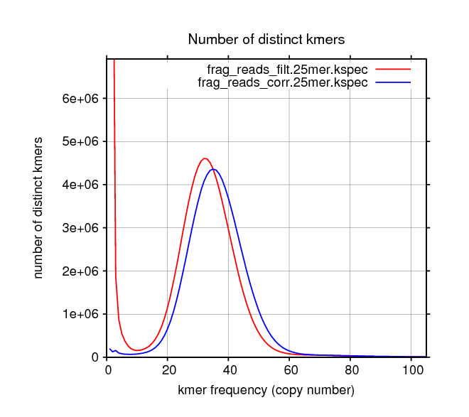
Error correction
Essentially, the error correction algorithm removes k-mers with a few copies and correct reads carrying these errors.
uncorrected reads
corrected reads
from Allpaths-LG

Slide 27
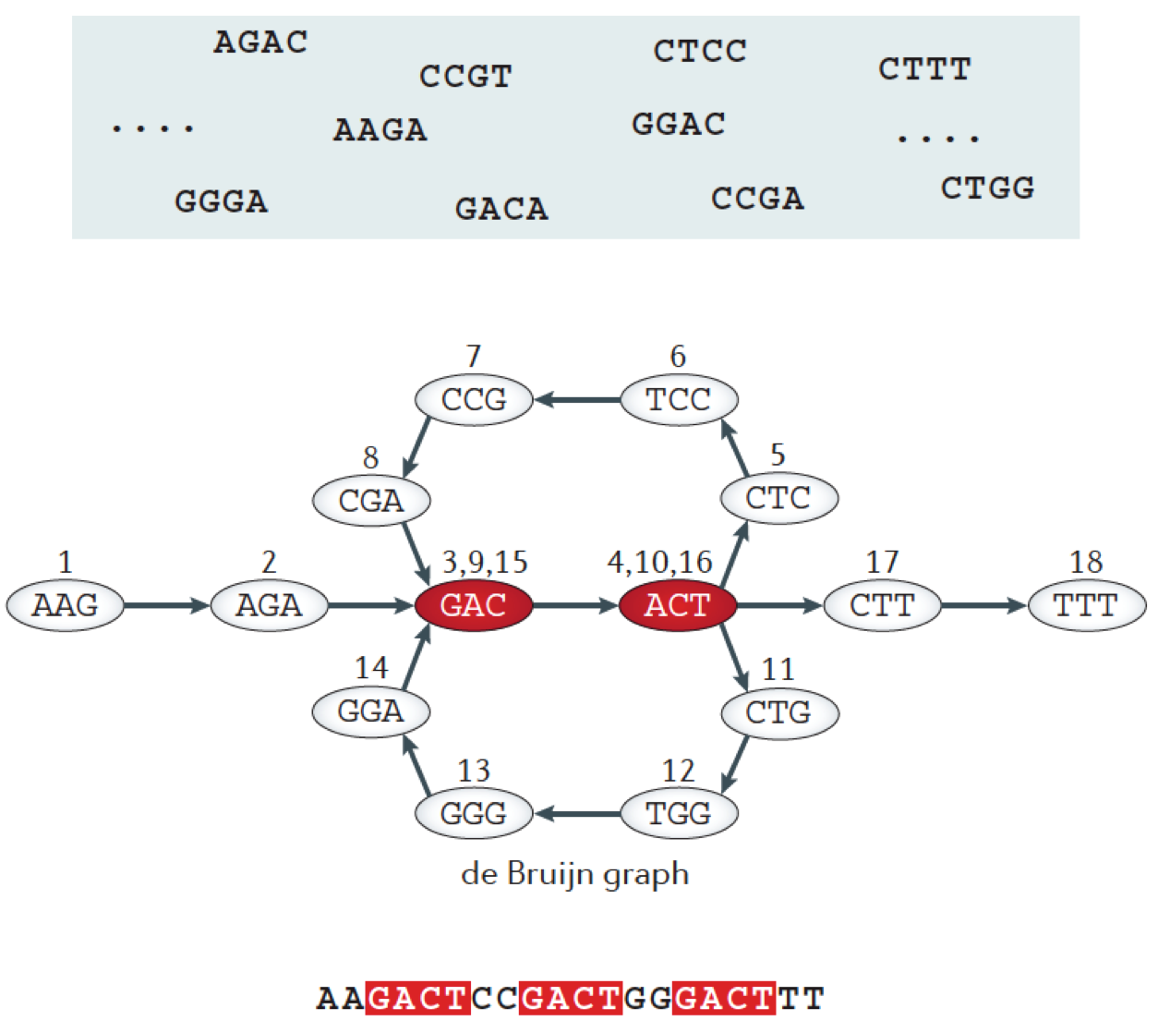
Repeats
Berger, B., et al., 2013 Nature Reviews Genetics 14: 333-346.

Slide 28
Unresolved repeats produce gaps
Long repeats, especially for those whose lengths are longer than read length, and high-copy repeats are challenging to resolve. If no other information can be used to assist in resolving repeats, gaps will be introduced.
What strategies can be used to resolve repeats?
Miller et al., 2010. Genomics 95: 315-327

Slide 29
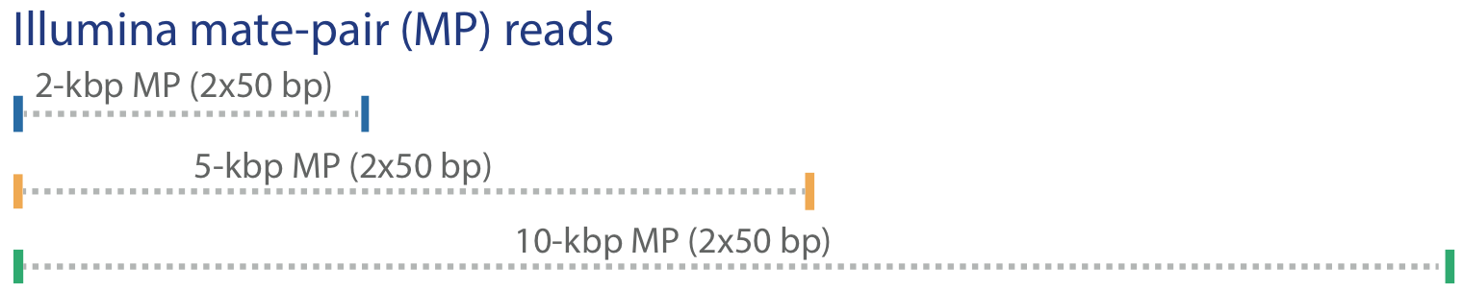
Some strategies to resolve repeats
Mate-pair reads, long reads (e.g., PacBio), genetic map, Hi-C data, and physical map (BioNano) can resolve some repeats
Miller et al., 2010. Genomics 95: 315-327

Slide 30
Gaps due to other reasons
Low sequence coverage (depth)
Sequencing biases (e.g., regions recalcitrant to sequencing)
CGGATCTGCGTGATACGGAATAGCCTAGCA
GATCTGCGTGATACGGAAT
ATCTGCGTGATACGGAATA
TCTGCGTGATACGGAATAG
CTGCGTGATACGGAATAGC
TGCGTGATACGGAATAGCC
CGTGATACGGAATAGCCT
6 (coverage; depth)
Recalcitrant genomic regions:
extremely high GC or AT
complicated secondary structure
Preferred genome sequencing reads:
Long reads
High-quality reads
High sequencing depth (at least 30x)
No sequencing biases

Slide 31
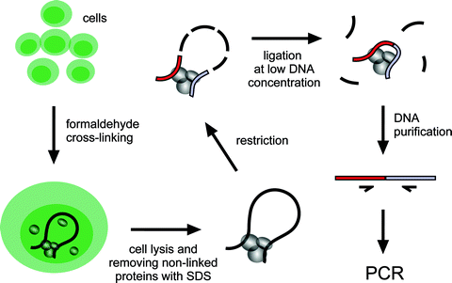
Hi-C: the method to quantify physical interactions between all possible pairs of genomic regions simultaneously
Inside a cell, genomic regions in a chromosome are physically connected to form chromosome conformation. Closer genomic regions generally have higher frequent physical contacts than regions far apart in distance.
MMB, 567:171-188

Slide 32
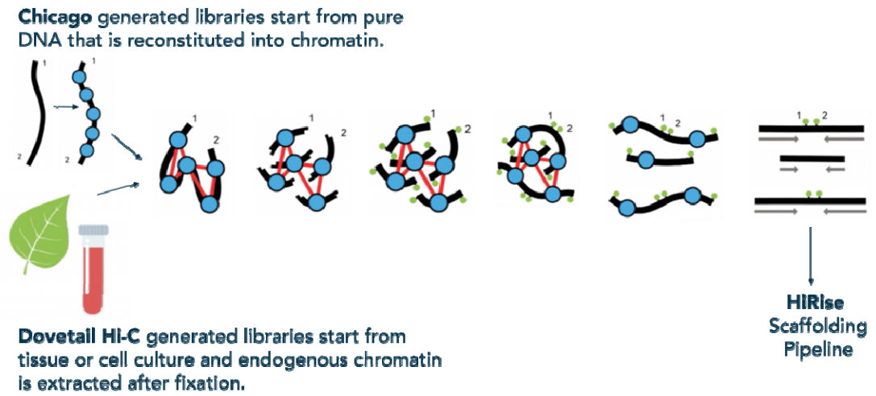
Chicago + Dovetail Hi-C
Chicago generated libraries starting from pure DNA that is reconstituted into chromatin
HiRise scaffolding pipeline
Dovetail Hi-C generated libraries starting from tissue or cell culture and endogenous chromatin
https://youtu.be/OIxFFB3daIM
https://www.biorxiv.org/content/biorxiv/early/2018/08/15/392126.full.pdf

Slide 33
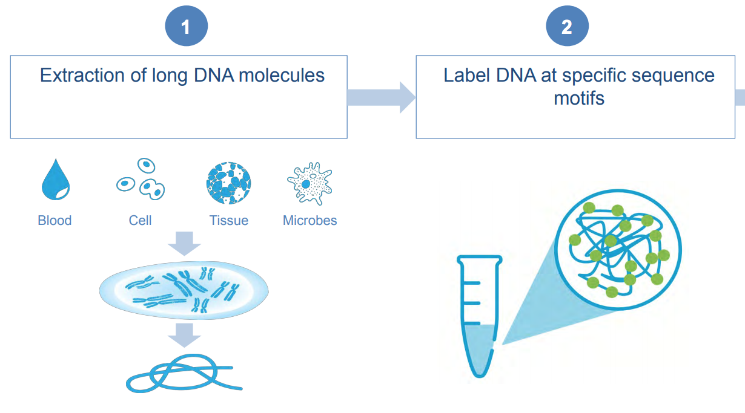
BioNano – library preparation
e.g., DLE-1 (CTTAAG)
Direct label enzyme
https://bionanogenomics.com/wp-content/uploads/2019/03/Bionano-Genomics_Poster_PAG-2019_A-Lee_S-Bocklandt_Hybrid-Scaffold.pdf

Slide 34
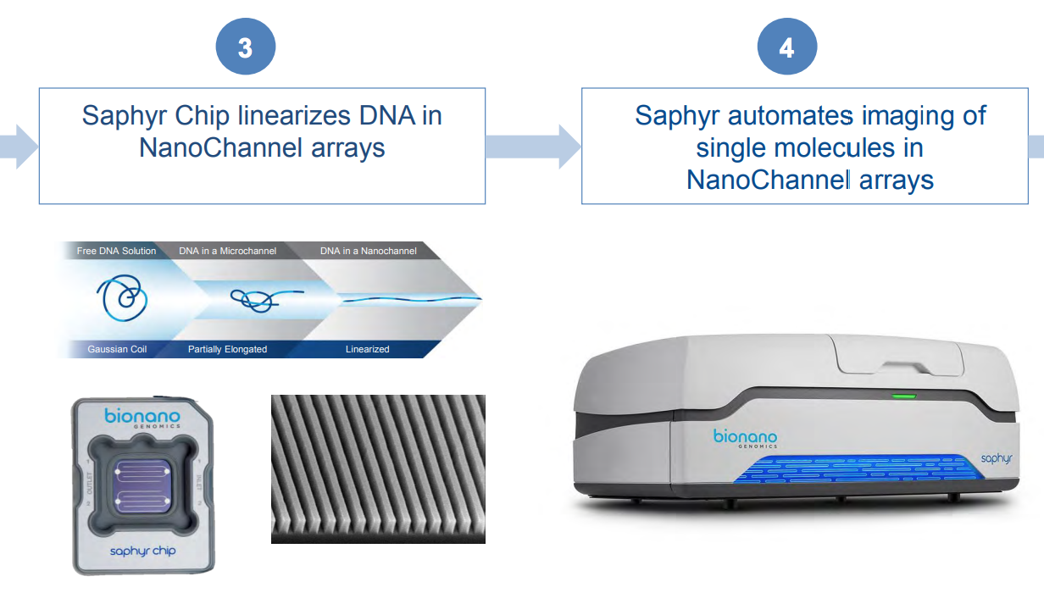
BioNano – running on Saphyr
https://bionanogenomics.com/wp-content/uploads/2019/03/Bionano-Genomics_Poster_PAG-2019_A-Lee_S-Bocklandt_Hybrid-Scaffold.pdf

Slide 35
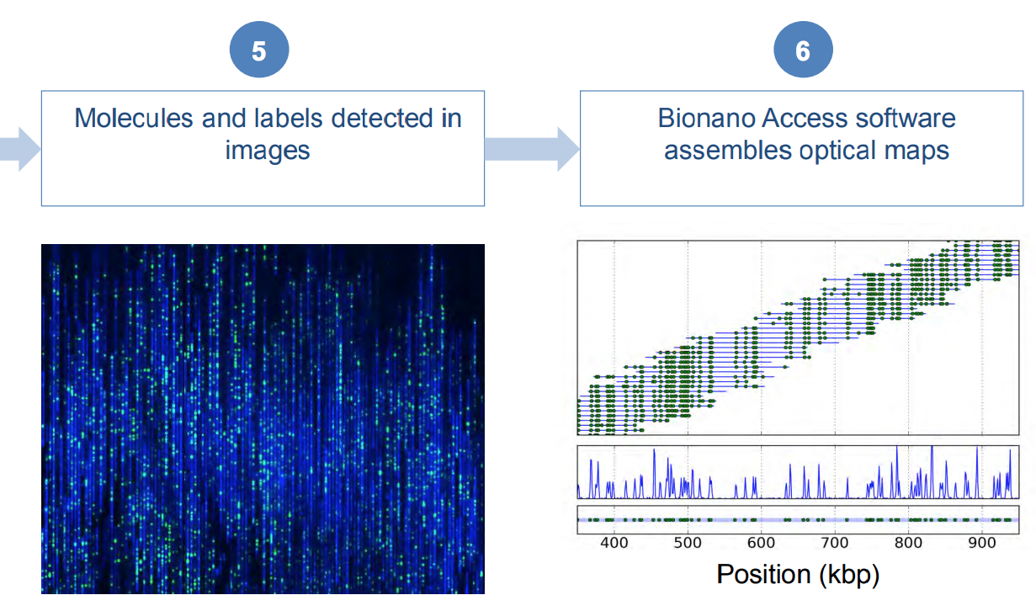
BioNano – image analysis and assembly of molecular data
https://bionanogenomics.com/wp-content/uploads/2019/03/Bionano-Genomics_Poster_PAG-2019_A-Lee_S-Bocklandt_Hybrid-Scaffold.pdf

Slide 36
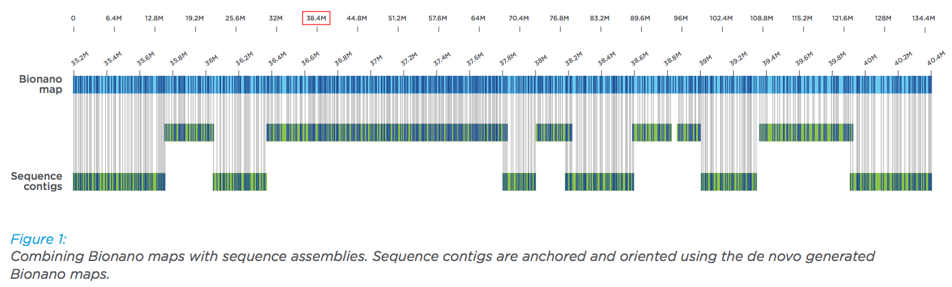
BioNano scaffolding
https://bionanogenomics.com/wp-content/uploads/2017/02/Bionano_HumanPAG_Hybrid-Scaffolding-White-Paper.pdf

Slide 37
Assembly statistics – N50 and L50
N50: A statistic used for assessing the contiguity of a genome assembly.
L50: The number of contigs whose summed length is N50.
The contigs in an assembly are sorted by size and added, starting with the largest. The contig N50 is the size of the contig that makes the total greater than or equal to 50% of the total contig size.
OR: The contig N50 is the length of the smallest contig in the set that contains the fewest (largest) contigs whose combined length represents at least 50% of the assembly.

Slide 38
An example to determine N50 and NG50
Accumulated (kbp) | % ASM
615 | 13%
1,130 | 25%
1,642 | 36%
2,092 | 46%
2,452 | 53%
2,808 | 61%
3,118 | 68%
3,319 | 72%
3,508 | 76%
3,694 | 80%
3,854 | 84%
4,004 | 87%
4,124 | 90%
4,226 | 92%
4,321 | 94%
4,407 | 96%
4,489 | 98%
4,543 | 99%
4,575 | 100%
4,596 | 100%
assembly: 20 contigs
ctg_ID | ctg_size (kbp)
1 | 615
2 | 515
3 | 512
4 | 450
5 | 360
6 | 356
7 | 310
8 | 201
9 | 189
10 | 186
11 | 160
12 | 150
13 | 120
14 | 102
15 | 95
16 | 86
17 | 82
18 | 54
19 | 32
20 | 21
Total | 4,596
contig N50?
360 kbp

Slide 39
Assembly statistics – NG50
Problem of N50:
N50 values of the assemblies with significantly different total assembly space (lengths) are usually not comparable. Even if the same data set is used for the assembly.
50,000
30,000
10,000
50,000
40,000
30,000
20,000
10,000
NG50: The NG50 statistic is the same as N50 except that it is 50% of the known or estimated genome size. This allows for meaningful comparisons between different assemblies.

Slide 40
An example to determine N50 and NG50
Genome size: 5 Mbp
20 contigs
Accumulated (kbp) | % ASM | % genome
615 | 13% | 12%
1,130 | 25% | 23%
1,642 | 36% | 33%
2,092 | 46% | 42%
2,452 | 53% | 49%
2,808 | 61% | 56%
3,118 | 68% | 62%
3,319 | 72% | 66%
3,508 | 76% | 70%
3,694 | 80% | 74%
3,854 | 84% | 77%
4,004 | 87% | 80%
4,124 | 90% | 82%
4,226 | 92% | 85%
4,321 | 94% | 86%
4,407 | 96% | 88%
4,489 | 98% | 90%
4,543 | 99% | 91%
4,575 | 100% | 92%
4,596 | 100% | 92%
ctg_ID | ctg_size (kbp)
1 | 615
2 | 515
3 | 512
4 | 450
5 | 360
6 | 356
7 | 310
8 | 201
9 | 189
10 | 186
11 | 160
12 | 150
13 | 120
14 | 102
15 | 95
16 | 86
17 | 82
18 | 54
19 | 32
20 | 21
Total | 4,596
contig N50 360 bp
contig NG50?
356 kbp

Slide 41
Software for short-read assemblies
Software | Description | URLandreference
Velvet | Original de Bruijn graph assembler | http://github.com/dzerbino/velvet
SOAPdenovo | De Bruijn graph assembler with error-correction step | http://soap.genomics.org.cn/
Meraculous | Hybrid k-mer/read-based | https://jgi.doe.gov/data-and-tools/meraculous/
ALLPATHS-LG | Uses unipath graph to collapse repeats | http://software.broadinstitute.org/allpaths-lg/blog/
SGA | Uses string graphs | https://github.com/jts/sga
ABySS | Represents de Bruijn graph with a Bloom filter | https://github.com/bcgsc/abyss
DISCOVAR de novo | Requires 250-bp PCR-free reads | https://software.broadinstitute.org/software/discovar/blog/
Supernova | Assembles 10× linked reads | https://github.com/10XGenomics/supernova

Slide 42
Long-read assemblies and polishing
Long-read assemblies
Software | Description | URLandreference
HGAP | Error correction, OLC assembly, and polishing | https://github.com/PacificBiosciences/Bioinformatics-Training/wiki/HGAP
Canu | K-mer-based overlap computation | https://github.com/marbl/canu
FALCON | Assembles phased diploid genomes | https://github.com/PacificBiosciences/FALCON
Flye | Uses A-Bruijn graph | https://github.com/fenderglass/Flye
Miniasm | Fast, but no error correction | https://github.com/lh3/miniasm
Polishing
Software | Description | URLandreference
Pilon | Uses short-read alignments to correct errors | https://github.com/broadinstitute/pilon
Arrow | Hidden Markov model and long-read alignments | https://github.com/PacificBiosciences/GenomicConsensus
Nanopolish | Nanopore only; uses voltage data to correct errors | https://github.com/jts/nanopolish

Slide 43
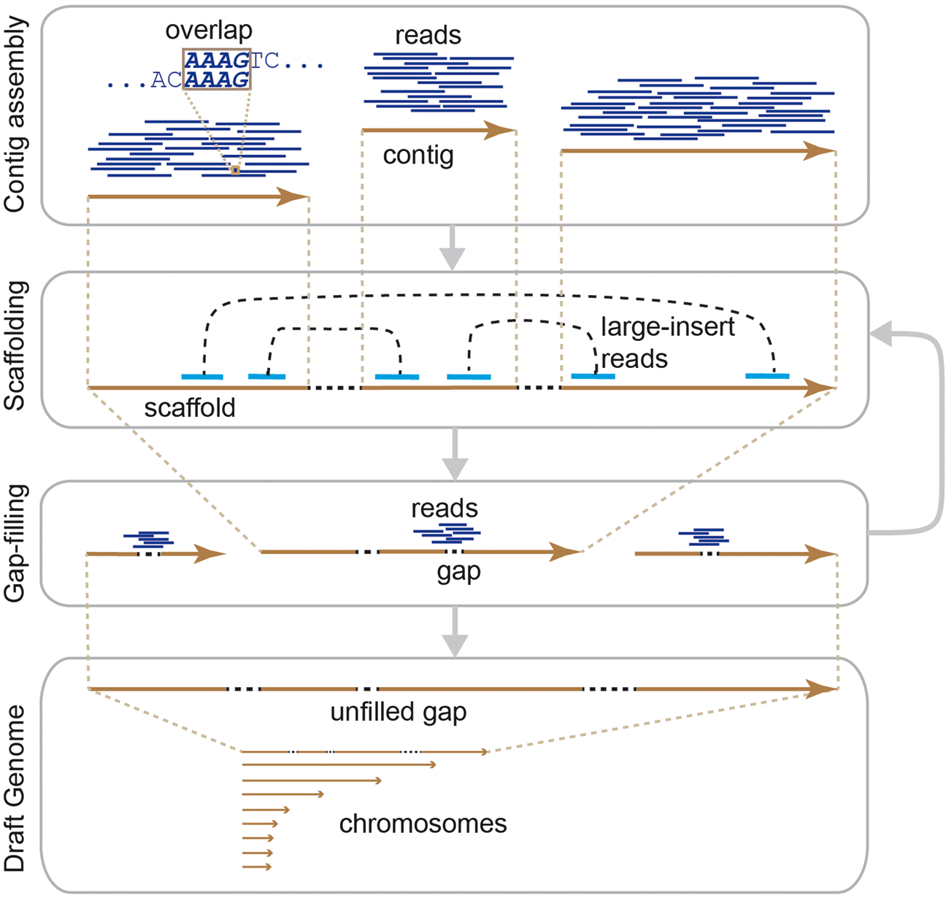
General workflow of de novo assemblies
pseudochromosomes
Notes:
Figure 1 General workflow of the de novo assembly of a whole genome. By overlapping reads, contigs are assembled from short reads before scaffolding by large-insert reads, and the remaining gaps are filled. The scaffolding and gap-filling steps can be iteratively performed until no contigs are scaffolded or no additional gaps are resolved before completion. Through this procedure, a draft genome consisting of chromosomes is built. Some unfilled gaps may remain in the draft genome.
Unless provided in the caption above, the following copyright applies to the content of this slide: © The Author 2016. Published by Oxford University Press. All rights reserved. For Permissions, please email: journals.permissions@oup.comThis article is published and distributed under the terms of the Oxford University Press, Standard Journals Publication Model (https://academic.oup.com/journals/pages/about_us/legal/notices)

Slide 44
Assemblies are hypotheses
... there will always be some degree of error in the characterized genome sequence, both on the level of individual nucleotides and in the ordering of sequence blocks. ..., every genome assembly is the result of a series of assembly heuristics and should accordingly be treated as a working hypothesis.
Evolutionary Conservation, 7:1026-1042, 2014

Slide 45
Assembly evaluation
No. of contigs: the total number of contigs in the assembly.
Largest contig: the length of the largest contig in the assembly.
Total length: total assembly length
Nxx (N50), NGxx (NG50)
Using a reference genome, No. of misassemblies, No. INDEL per 100 kbp, and No. of mismatches per 100 kbp are reported
Gurevich et al., 2013 Bioinformatics 29: 1072-1075.

Slide 46
Outline
Genome assembly: concept
Assembly algorithms: OLC/De Bruijn graph
Error correction (Kmer counts)
Assembly strategy to cope with the repeat problem
(mate-pair reads, long reads, others)
Assembly evaluation (N50, comparison to a reference genome)
Genome annotation

Slide 47
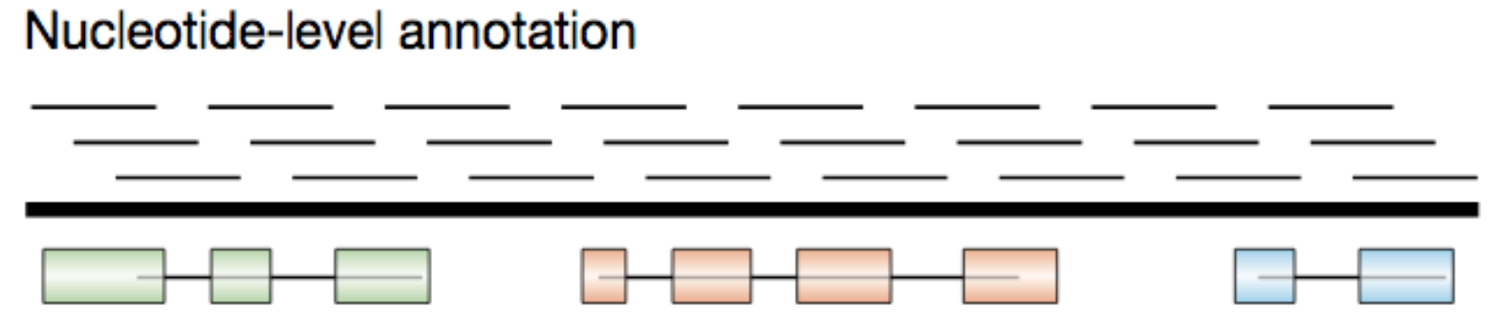
Gene annotation of eukaryotic genomes
Gene prediction from genomic DNA sequences:
to predict the exon-intron structures of the protein-encoding portions of transcripts (open reading frames or ORFs) and untranslated regions (UTR).

Slide 48
Gene prediction approaches
ab initio gene prediction (Hidden Markov Model)
to assign probability scores to many potential coding exons, and then join consecutive high-scoring exons with consistent reading frames to form high-scoring exon–intron structures
Evidence-driven gene prediction (e.g., RNA sequencing data)

Slide 49
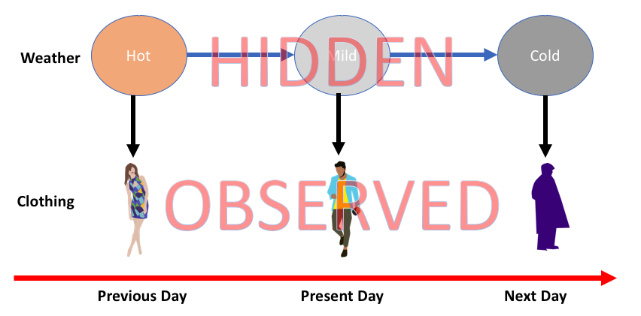
Hidden Markov Model (HMM)
Hidden states
HMM is a class of probabilistic graphical model that is used to predict a sequence of unknown (hidden) variables from observed variables.
https://medium.com/@postsanjay/hidden-markov-models-simplified-c3f58728caab

Slide 50
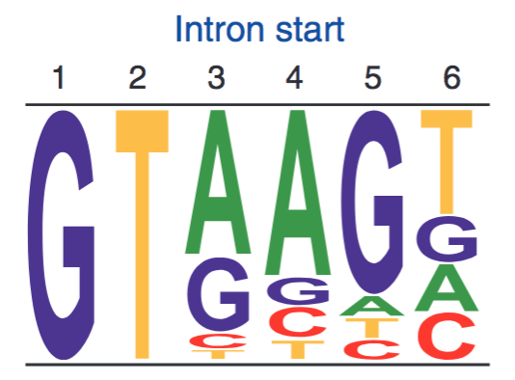
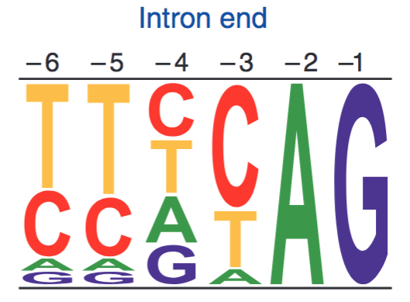
Exon-intron structure
Sequence logos represent weight matrices for the first six bases of an intron (left) and the last six bases of an intron (right). In plants and animals, ~99% of introns begin with GT.
exon
intron
exon
GT
AG
Other genomic sequence patterns: translation initiation and termination sites.
Notes:
termination sites: UAA, UGA, or UAG

Slide 51
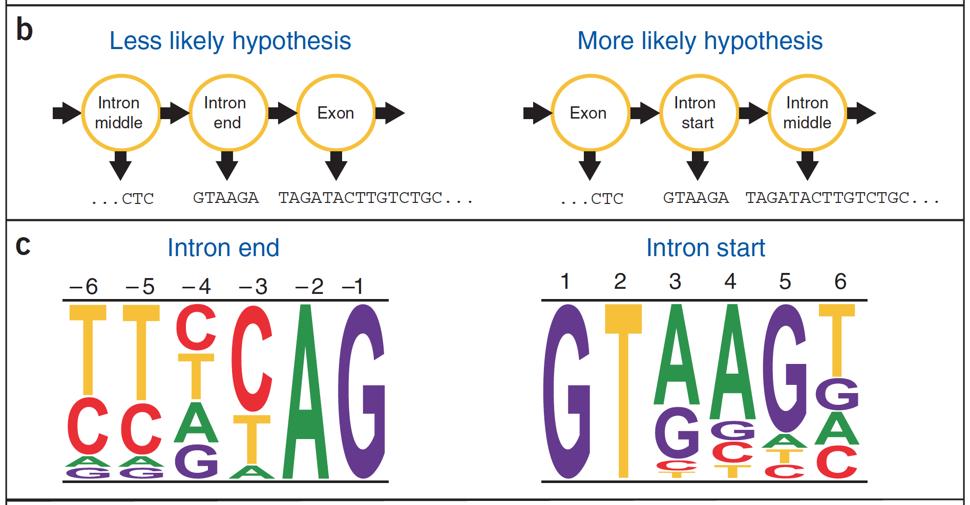
Generalized Hidden Markov Model (GHMM)

Slide 52
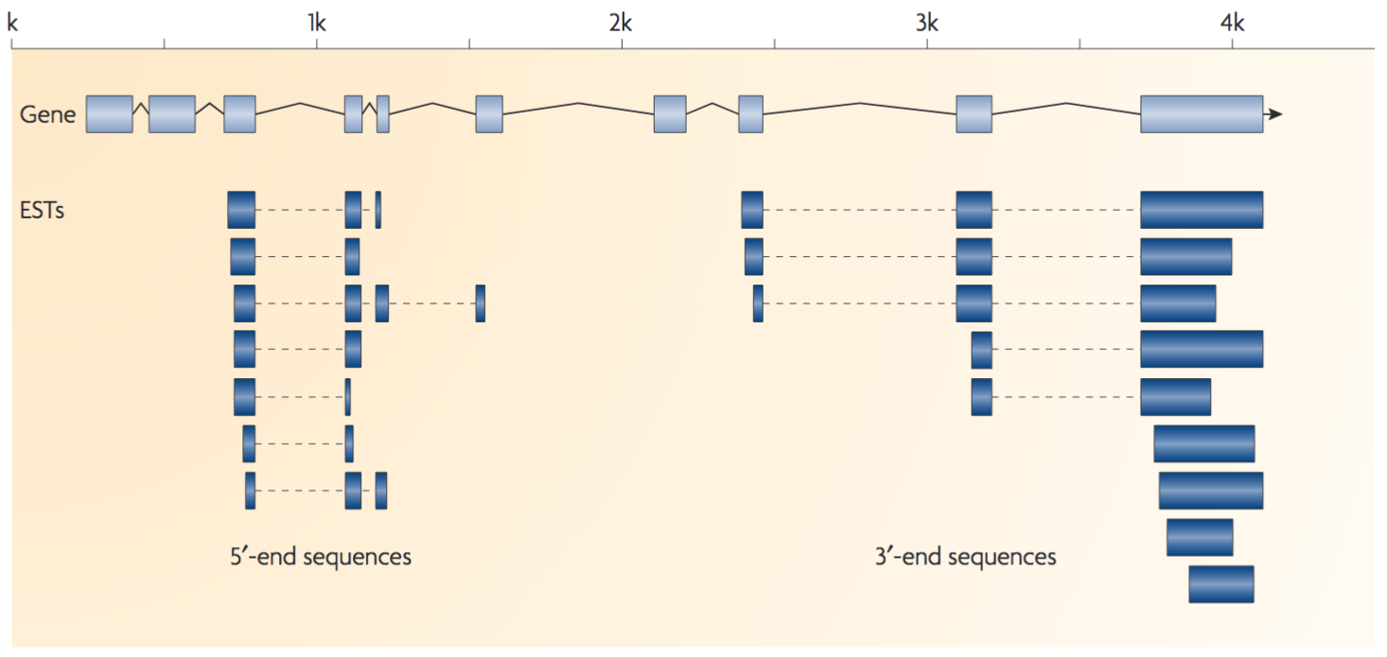
Evidence-driven approaches
Ideally, full-length cDNA sequences of all genes are collected for evidence-based genome annotation.

Slide 53
evidence and limitations
Full-length cDNAs
Protein sequences
Expression sequence tags (ESTs)
RNA-Seq (de novo assembly and alignment-based)
Limitations:
Full-length cDNA databases are not available
Not all genes are transcribed at sufficient levels at certain conditions
Alignments produce errors

Slide 54
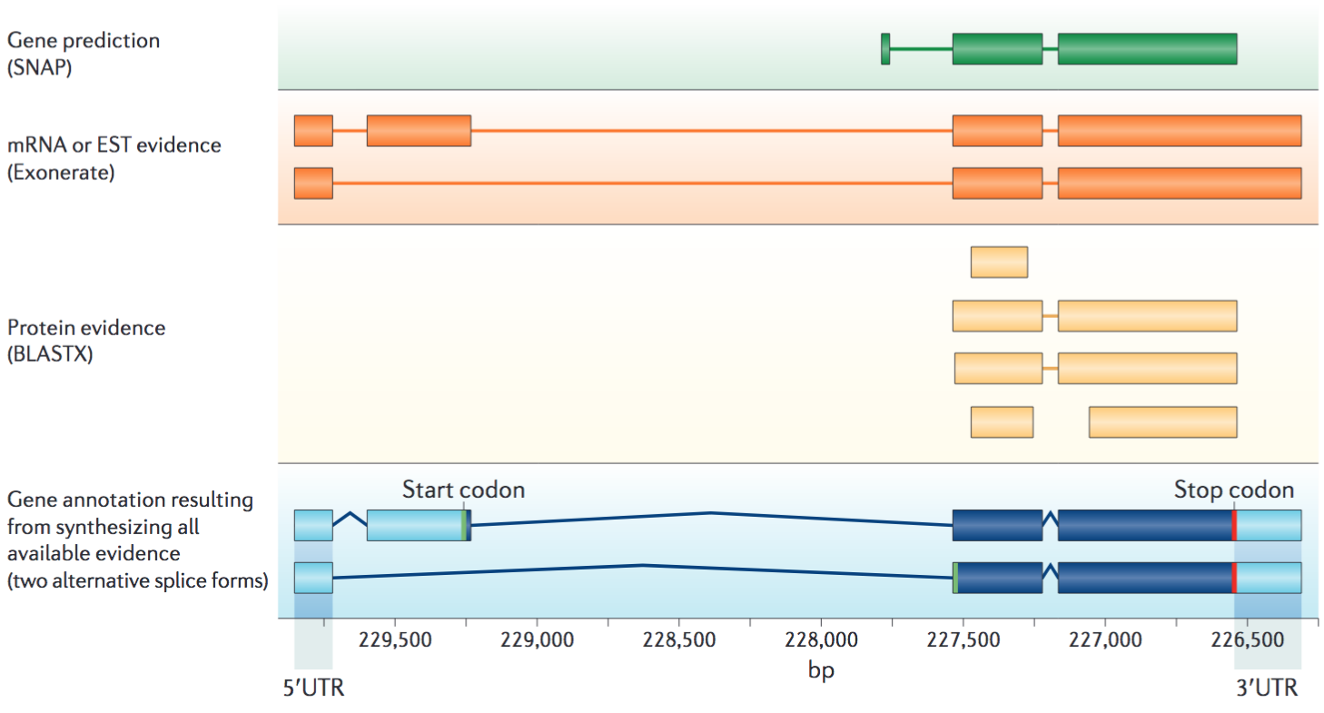
annotation: ab initio prediction + evidence
Nature Reviews Genetics 13:329–342 (2012)

Slide 55
Question?
What method can you figure out to assess the completeness of a genome annotation?

Slide 56
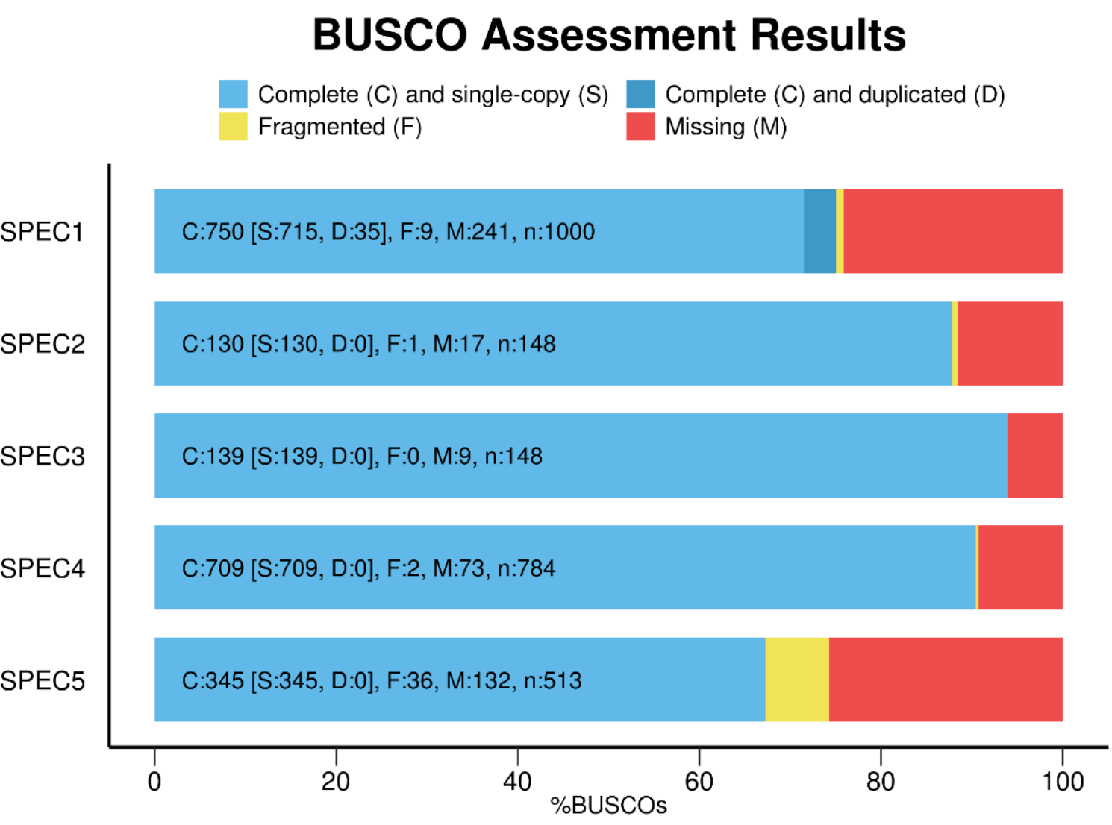
Evaluation with BUSCO
Assessing genome assembly and annotation completeness with Benchmarking Universal Single-Copy Orthologs.
file:///Users/liu3zhen/Downloads/BUSCO_v3_userguide.pdf

Slide 57
Outline
Genome assembly: concept
Assembly algorithms: OLC/De Bruijn graph
Error correction (Kmer counts)
Assembly strategy to cope with the repeat problem
(mate-pair reads, long reads, others)
Assembly evaluation (N50, comparison to a reference genome)
Genome annotation
Case study

Slide 58
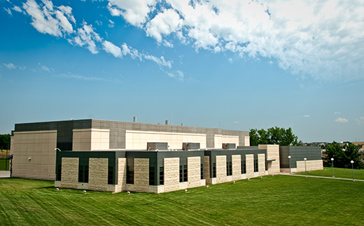
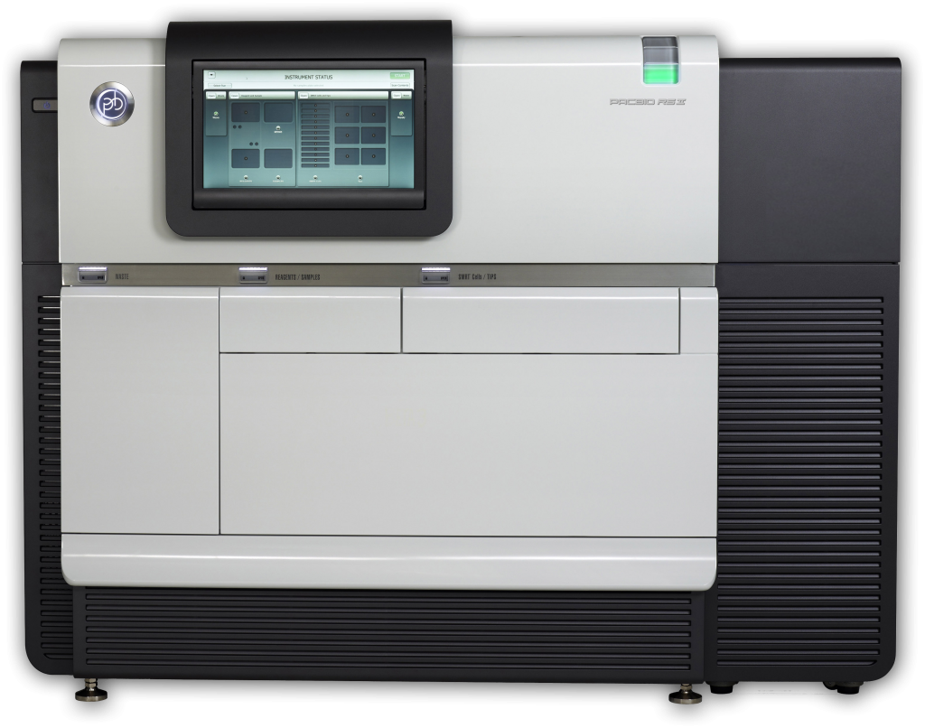
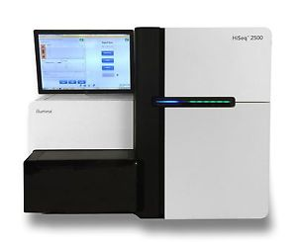
Case study: genome assembly of a wheat blast fungal strain
K-State BRI
10 SMRTCell PacBio data (P6-C4)
Longest reads: 74,474 bp
Coverage*: 276x
PacBio RS II
PCR-free Illumina TruSeq data
>2x10⁷ pairs of 2x250 paired-end reads
Coverage*: 222x
HiSeq 2500
* assuming the genome size is 45 Mb

Slide 59
Summary of the assembly
List of contigs (N=31)
Contig | Length (bp) | GC%
tig00000000 | 7,902,655 | 51.2
tig00000024 | 7,531,155 | 49.1
tig00000030 | 6,090,985 | 50.2
tig00000003 | 5,402,116 | 51.2
tig00000011 | 4,657,194 | 49.2
tig00000004 | 4,442,877 | 51.2
tig00000005 | 4,042,640 | 49.2
tig00000001 | 1,778,515 | 46.4
tig00000014 | 461,599 | 49.4
tig00000025 | 398,015 | 44.3
tig00000039 | 253,502 | 45.1
tig00000026 | 240,676 | 43.8
tig00000018 | 237,459 | 47.4
tig00000016 | 184,678 | 48
tig00000007 | 138,010 | 49.9
tig00000022 | 110,918 | 46
tig00000020 | 78,737 | 49.6
tig00000006 | 69,533 | 51.1
tig00000033 | 69,131 | 49.2
tig00000043 | 57,199 | 28.4
tig00000015 | 51,862 | 48.5
tig00000008 | 47,134 | 47.6
tig00000031 | 42,261 | 48.6
tig00000041 | 36,641 | 52.5
tig00000023 | 36,455 | 44.2
tig00000037 | 35,037 | 48.9
tig00000032 | 32,608 | 49.7
tig00000017 | 28,099 | 51.7
tig00000038 | 27,162 | 49.5
tig00000019 | 25,161 | 51.2
tig00000027 | 12,906 | 47.3
Statistics of the assembly*
Item | Statistics
total contig number | 31
total contig length | 44,522,920
longest contig | 7,902,655
shortest contig | 12,906
N50 | 5,402,116
overall GC | 0.50
min contig GC | 0.28
* Canu for PacBio assembly
Quiver polishing
Further error correction using Illumina data
# mitochondial sequence

Slide 60
BAC-end sequencing for assembly improvement?
+ insert
long genomic DNA fragment (e.g., 200 kb)
Vector
scaffolding
Vector
contig 1
contig 2
BAC
Sequence BAC ends of clones one by one, which is very low-throughput and cost-inefficient.

Slide 61
Idea: build random barcodes in vectors to enable a high throughput (I)
code (Red)
Vector with barcode (Red)
BAC
Sequences with barcode
Notes:
no needs to do single clone manipulation

Slide 62
Idea: build random barcodes in vectors to enable a high throughput (II)
Paired ends based on barcodes
millions of barcoded vectors in a pool
High-throughput
end sequencing
tens of thousands of clones
Notes:
no needs to do single clone manipulation

Slide 63
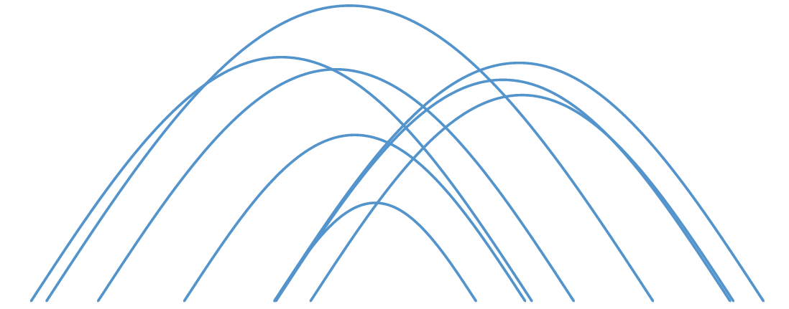
LIEP Scaffolding to improve the B71 assembly
LIEP scaffolding
Long Distance End Pairs (LIEP)
contig 1
contig 2
scaffolding two contigs to a sequence
~95% are long-distance read pairs

Slide 64
MoT B71 final assembly vs. MG8 (70-15, rice strain)
Chr | Length (bp)
chr1 | 6,442,091
chr2 | 7,902,655
chr3 | 8,206,304
chr4 | 5,402,116
chr5 | 4,442,877
chr6 | 6,090,985
chr7 | 4,042,640
scaf1 | 941,816
scaf2 | 739,928
scaf3 | 104,670
scaf4 | 74,396
scaf5 | 69,131
Wheat
blast fungal strain
rice blast fungal reference
>10 kb overlap and >95% identity
Notes:
the two genomes are largely co-linear except for a few rearrangements, insertions, inversions.

Slide 65
Citations
Berger, B., J. Peng, M. Singh, Computational solutions for omics data. Nature Reviews Genetics 14: 333-346 (2013).
Compeau, P. E. C., P. A. Pevzner, G. Tesler, How to apply de Bruijn graphs to genome assembly. Nature Biotechnology 29: 987-991 (2011).
Nagarajan, N., M. Pop, Sequence assembly demystified. Nature Reviews Genetics 14: 157-167 (2013).
Miller, J. R., S. Koren, G. Sutton, Assembly algorithms for next-generation sequencing data. Genomics 95: 315-327 (2010).
Brent, M. R. How does eukaryotic gene prediction work? Nat. Biotechnol. 25, 883–885 (2007).
Stein, L. Genome annotation: from sequence to biology. Nat. Rev. Genet. 2, 493–503 (2001).
Yandell, M., Ence, D. A beginner’s guide to eukaryotic genome annotation. Nat. Rev. Genet. 13, 329–342 (2012).
Simão, F. A., et al. BUSCO: assessing genome assembly and annotation completeness with single-copy orthologs. Bioinformatics 31, 3210–3212 (2015).

